Slide 1
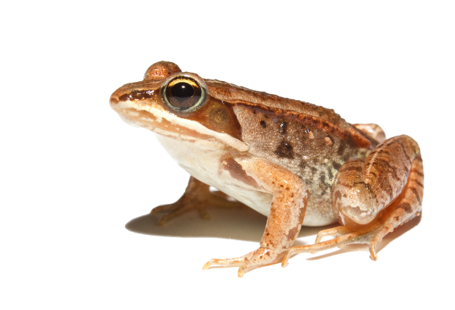

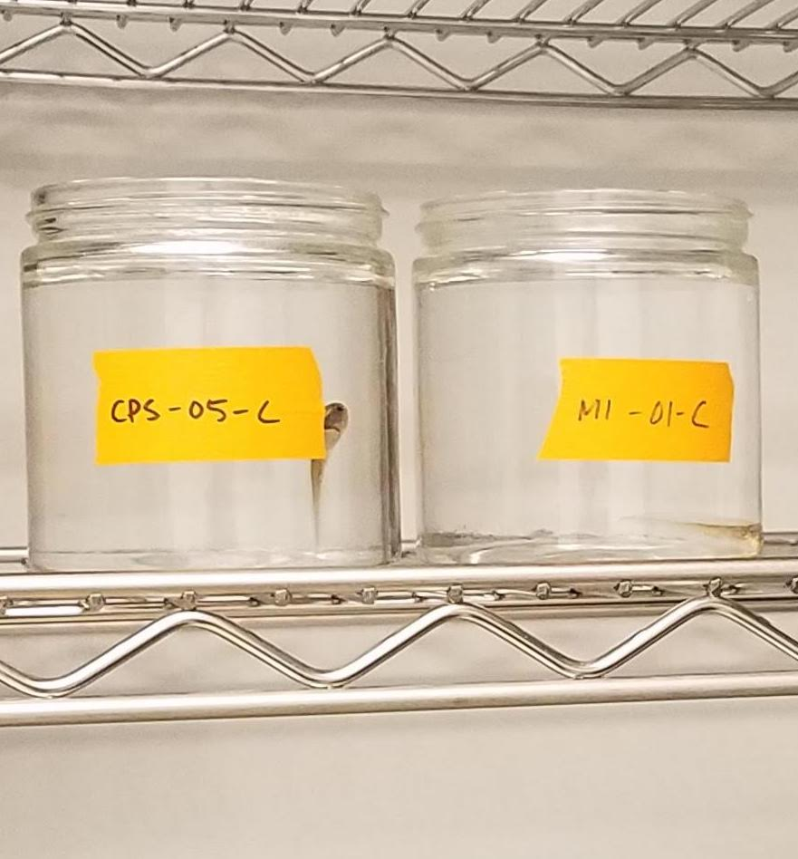
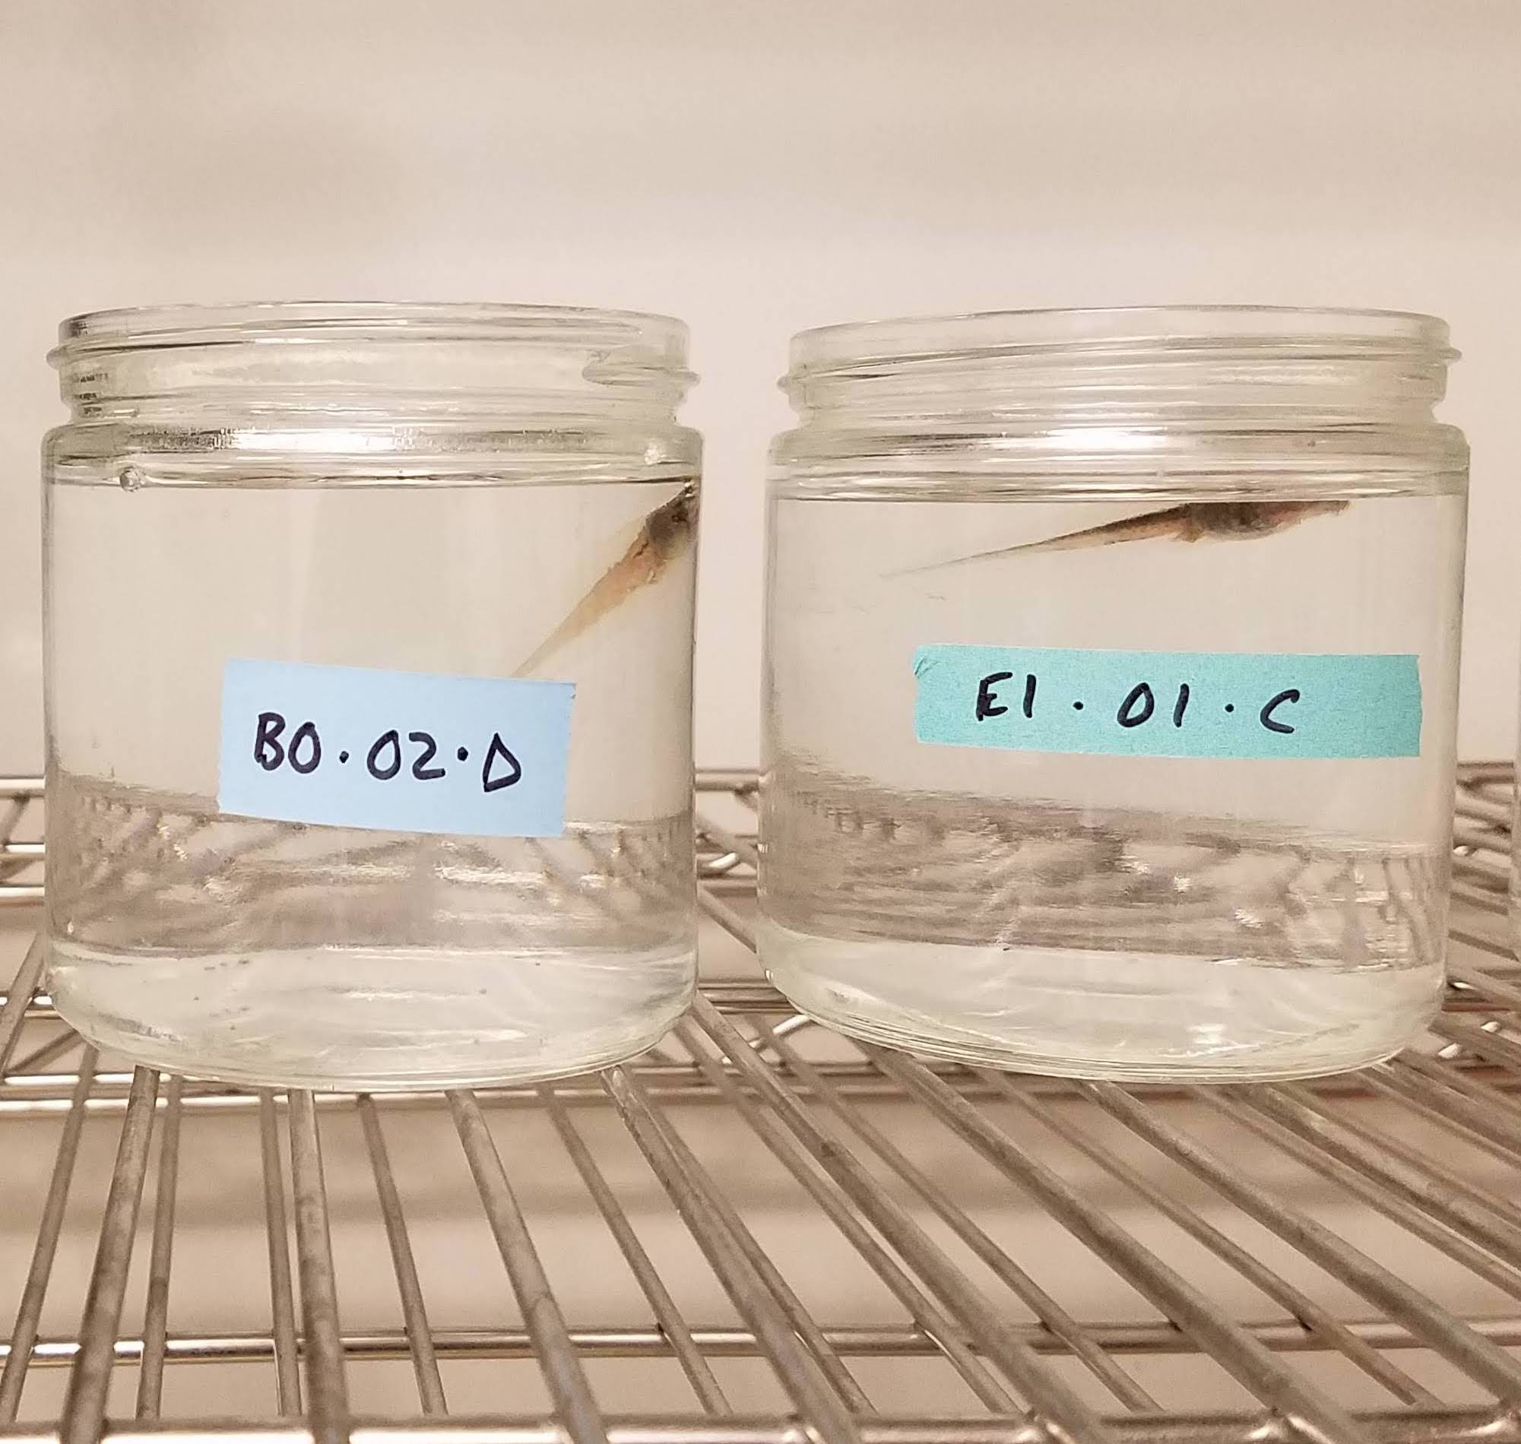
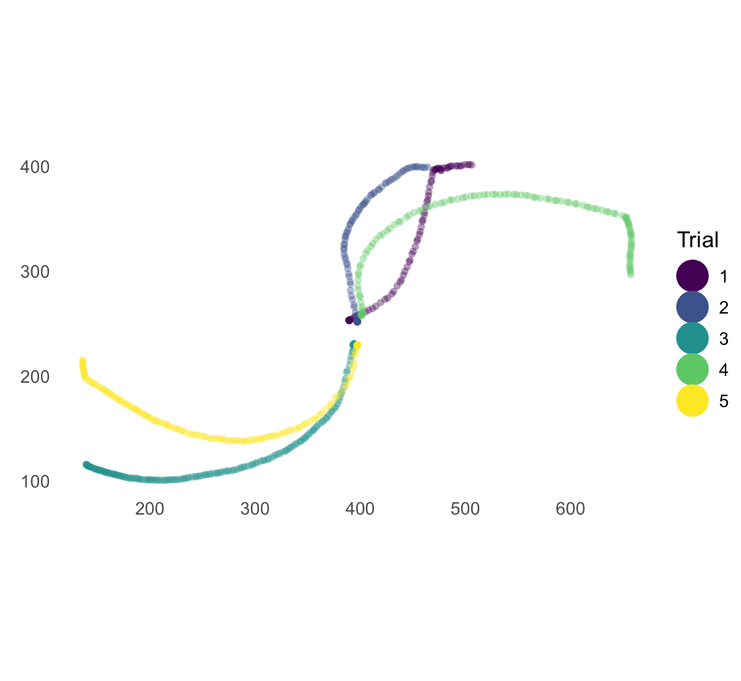
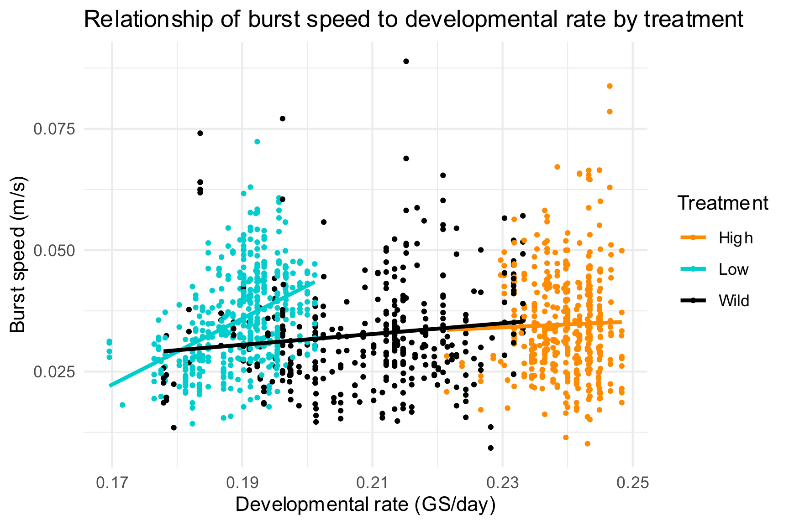
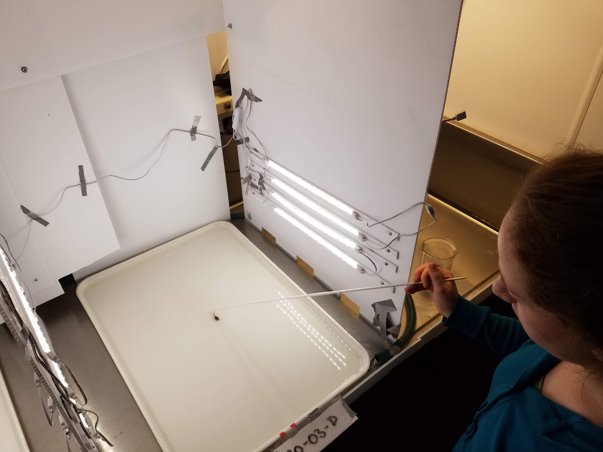
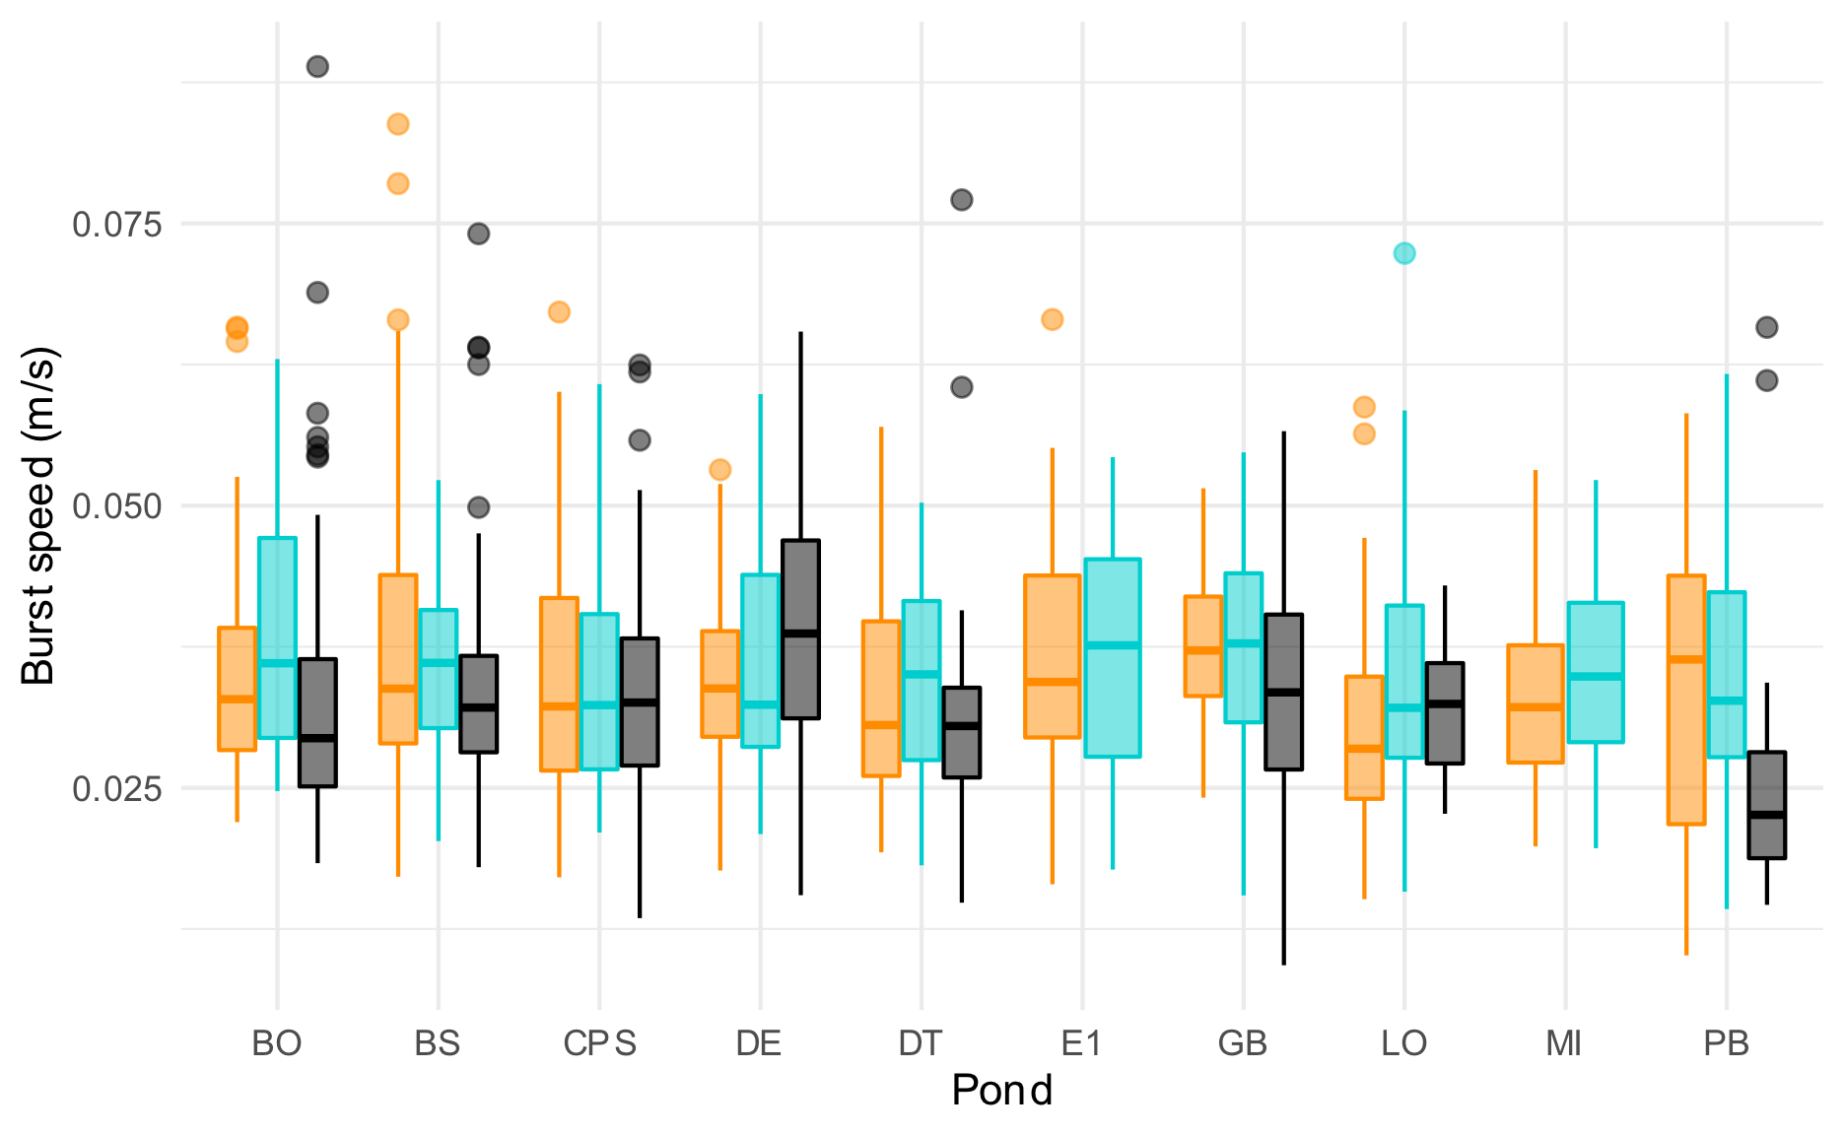
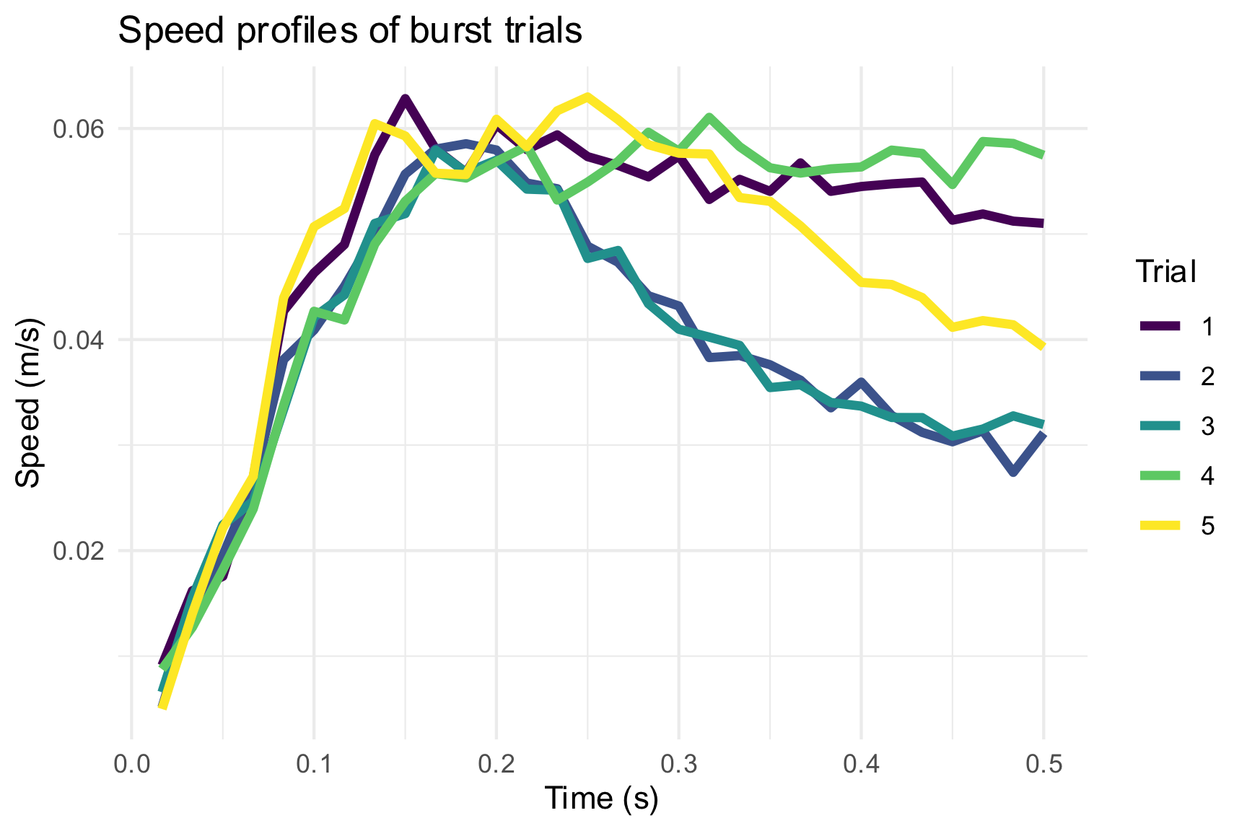
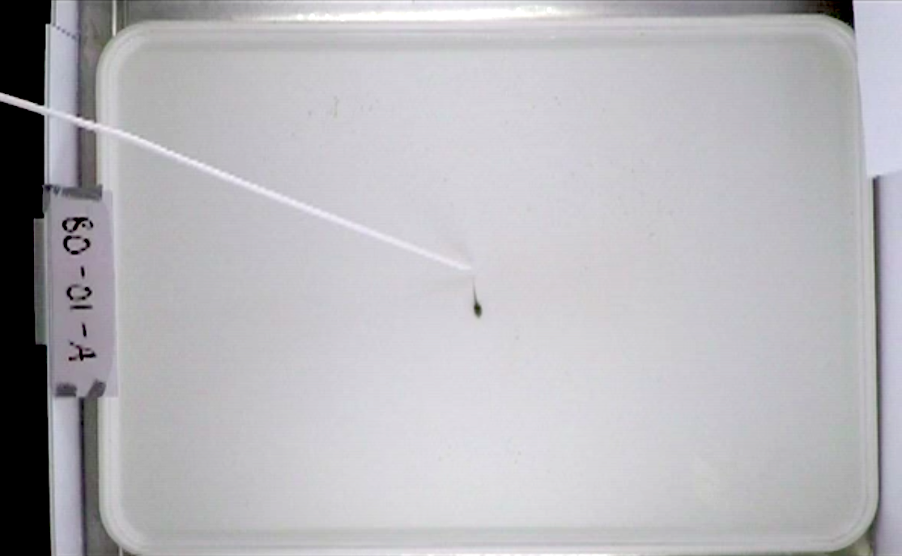
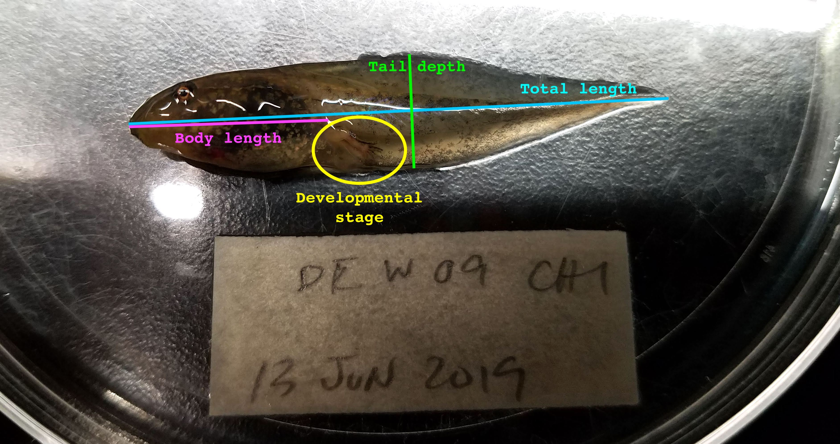
Tradeoffs between Developmental Rate and Swimming Performance in Wood Frog (Rana sylvatica) Larvae
Kaija Gahm¹, Andis Arietta², & David Skelly²
¹Department of Ecology & Evolutionary Biology, ²School of Forestry & Environmental Sciences
Introduction
Methodology
Preliminary Results
The wood frog (Rana sylvatica) is widely distributed across the northern U.S. and Canada. It breeds in ephemeral wetlands, which dry up in the summer.
Wood frogs start breeding as soon as pond ice melts in the spring. Their aquatic larvae (tadpoles) must develop rapidly enough to transform into terrestrial adults before their ponds dry up in the summer.
Climate change is putting pressure on wood frog development:
Delayed spring ice melt means that breeding starts later.
Increased summer temperatures speed pond drying.
As a result, tadpoles are under pressure to develop more rapidly.
Burst speed by developmental rate
Eggs were collected from several ponds in Yale Myers Forest and reared at high and low temperature treatments. For comparison, wild-raised tadpoles from the same ponds were also tested.
1
Frame-by-frame coordinates were combined to visualize the tadpole’s path in each of several trials.
4
"Treatment"
Burst speed by pond
An ephemeral pond in Yale Myers Forest. Wood frog development is constrained on one end by spring ice melt. Photo from the Skelly Lab.
Why wouldn’t it be good to develop quickly and get a head start?
Organisms that grow and develop quickly may have to compromise other traits.
Silverside fish: reduced swimming performance and metabolic capacity (Arnott et al. 2006).
Toad tadpoles: slower burst swimming (Arendt 2003).
A pilot study in the Skelly lab last year suggests that wood frogs might also display this trade-off.
Trade-offs at the genetic level, or as a result of phenotypic plasticity?
Tested tadpoles from a variety of ponds of different temperatures to find effects of intrinsic growth rate.
Lab-reared tadpoles under two different temperature regimes to test plasticity.
2
A probe startled each tadpole into swimming, simulating a predator attack. Trials were video recorded from above.
5
Speeds were calculated for each burst and visualized as a function of time during the first half second of the burst. To reduce noise, a moving average function was applied to the speed data.
Developmental rate had a different relationship to burst speed for each temperature treatment
No evidence that rapid development correlates with slower swimming. In fact, the low temperature group showed the opposite trend.
No clear differences across ponds
Next steps:
Mixed models to incorporate nested random effects
Incorporate morphological data: what does explain variation in burst speeds?
Other metrics: trajectory characteristics, max. instead of average speed
Relationship of burst speed to metabolism?
Hypothesis: If there is a tradeoff between developmental rate and swimming performance, then slower-developing tadpoles should have faster burst speeds than those with more rapid development.
References:
Arendt, J.D. 2003. Reduced burst speed is a cost of rapid growth in anuran tadpoles: Problems of autocorrelation and inferences about growth rates. Functional Ecology 17 (3): 328-34.
Arnott, S. A., S. Chiba, and D.O. Conover. 2006. Evolution of intrinsic growth rate: Metabolic costs drive trade-offs between growth and swimming performance in Menidia menidia. Evolution 60 (6): 1269-78.
Significance:
Will faster development push wood frogs to their physiological limits?
Studying wood frogs can help us understand how amphibians, more generally, might evolve in response to new and continuing pressures.
Thanks:
Adriana Rubinstein
Simon Stump
Kirby Broderick
Funding:
Yale College Dean’s Research Fellowship
Kohlberg-Donohoe Research Fellowship
Pierson College Richter Summer Fellowship
3
A custom-built MATLAB algorithm tracked the tadpole’s position in each frame of the video.
6
Following the burst trials, each tadpole was measured and staged.

